Slide 1
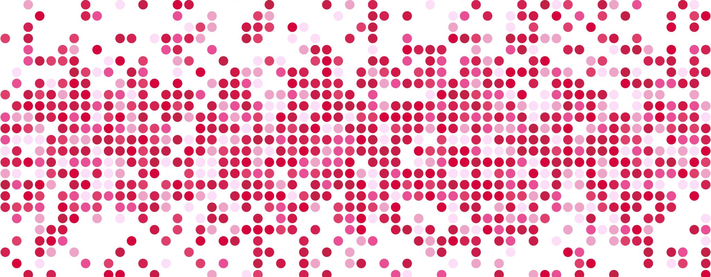
Classical Test Theory
Dr Oliver Clark [Oli]

Slide 2
This Week
True Score vs Observed Scores
Systematic and Unsystematic Error
Standard Error of Measurement
Confidence Intervals

Slide 3
This Video
Classical Test Theory
True Scores
Observed Scores
Error Scores

Slide 4
Classical Test Theory
Lord & Novick (1968)
Based on two theorems:
The True Score is the expectation of the observed score for a person.
The Error Score is the difference between the True Score and the Observed Score.

Slide 5
Classical Test Theory
True Score = Observed Score ± Error
Observed Score = True Score ± Error

Slide 6
Classical Test Theory
Relies on Reliability to connect Observed Scores to True Scores
• Test-Retest
• Parallel Forms
Split Half
Internal Consistency
Kurder Richardson 20
Cronbach’s Alpha
Omega

Slide 7
Classical Test Theory
Reliability -> Within-Subject Variation
Standard Deviation -> Between-Subject Variation
Both of these elements influence the Error Score

Slide 8
Classical Test Theory
From reliability and norm information, we can calculate the range of likely observed scores from a test taker:
Standard Error of Measurement
Confidence intervals
Standard Error of Difference

